Slide 1
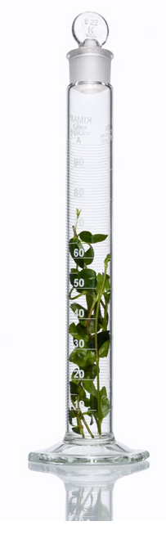
xINTERPDF User Guide v.0.1.0
Chenyang Shi, Senior Scientist at AbbVie Inc.
Updated June 15th, 2018
A video demo about installation and usage is available at https://www.youtube.com/watch?v=lAFZ5VYEH1g

Slide 2
Overview Installation Technical Terms Examples Disclosure/Acknowledgement

Slide 3
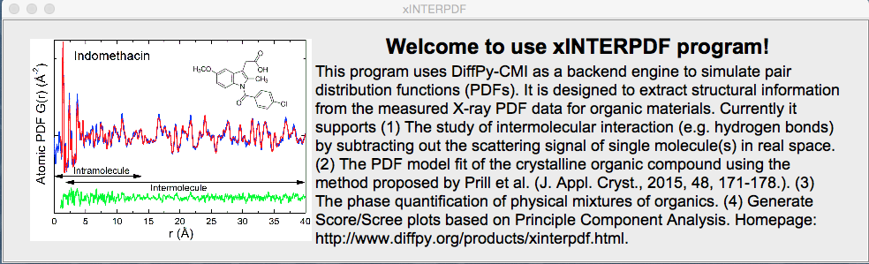
Overview
xINTERPDF is written in Python 2.7. It utilizes Tkinter and matplotlib modules for creating a Graphical User Interface (GUI) and plot visualization, and NumPy, SciPy and Scikit-learn (i.e. PCA feature) for scientific calculations. It builds on DiffPy-CMI package (http://www.diffpy.org/products/diffpycmi/index.html) for analysis of synchrotron/laboratory X-ray total scattering data collected for organic materials. The homepage for xINTERPDF is at https://www.diffpy.org/products/xinterpdf.html and its GitHub page is at https://github.com/curieshicy/xINTERPDF.

Slide 4
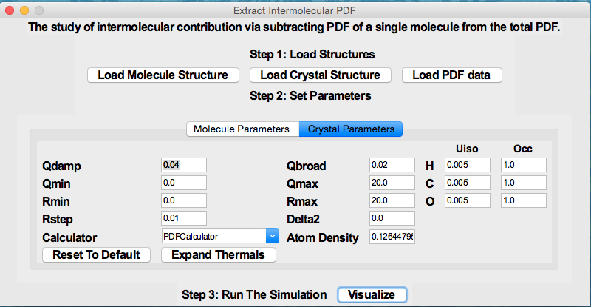
Usage 1: Extracting Intermolecular PDF
Users may use xINTERPDF to study the molecule-molecule interaction in organics. The program considers three common scenarios—the organic compound of interest is (1) crystalline (2) amorphous and (3) amorphous solid dispersion (two components). Shown below is an example when compound is crystalline, other two cases are similar.
To extract intermolecular interaction for crystalline organics, users first supply the structures for a single molecule (in xyz format) and a crystal (in cif format) and (optionally PDF data). Then in step 2, click Expand Thermals to bring up Uiso/Occ info. A variety of parameters for molecule and crystal will be specified by users. These include instrument parameters, thermal factors, occupancy and calculator to calculate PDF. In Step 3, hit Visualize to plot results.

Slide 5
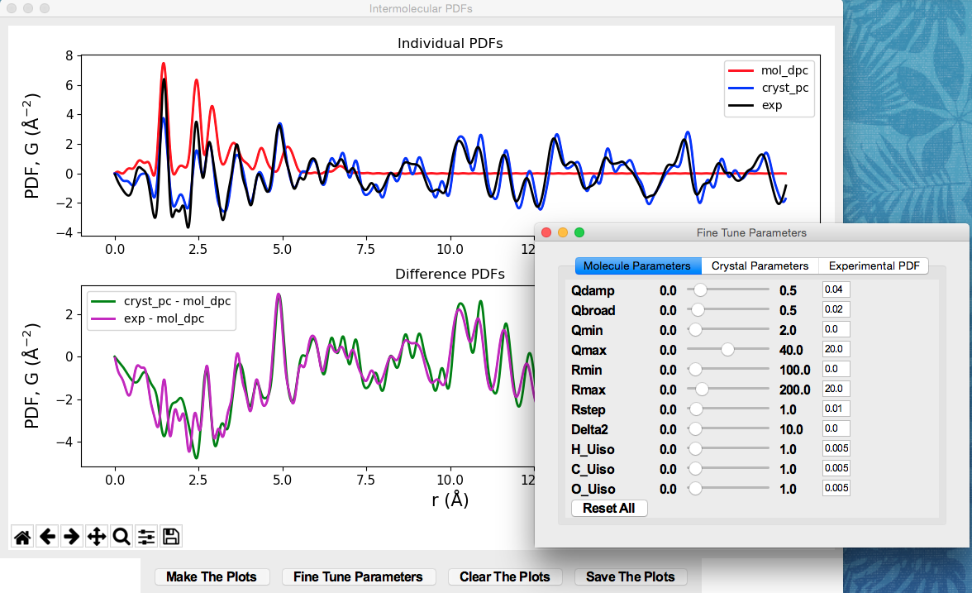
Usage 1: Extracting Intermolecular PDF
In the plot, the top panel shows the individual PDFs. In the example below, it shows the PDF (red) for molecule calculated by DebyePDFCalculator and PDF (blue) for a crystal using PDFCalculator. The experimental total PDF is shown in black. The bottom panel displays the theoretical/experimental intermolecular PDFs. Click Fine Tune Parameters to adjust the simulated plots. Hit Save the Plots to save raw data.

Slide 6
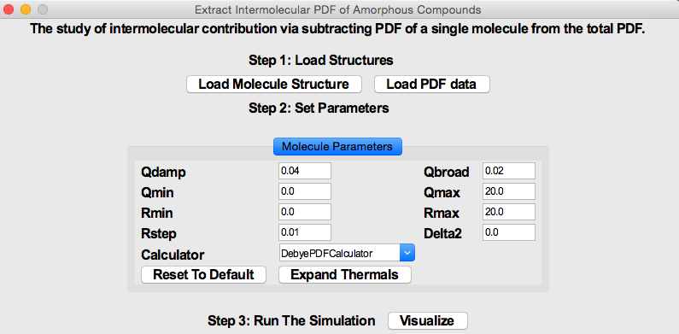
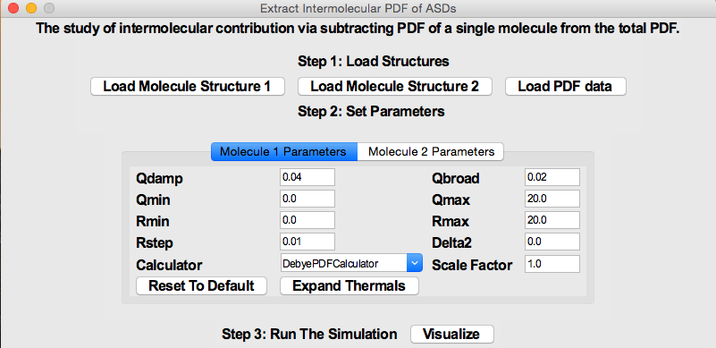
Usage 1: Extracting Intermolecular PDF
Similar to crystalline case, users can study intermolecular PDFs in amorphous compounds and amorphous solid dispersions. In both cases, only PDF(s) for molecule(s) is simulated and subtracted.

Slide 7
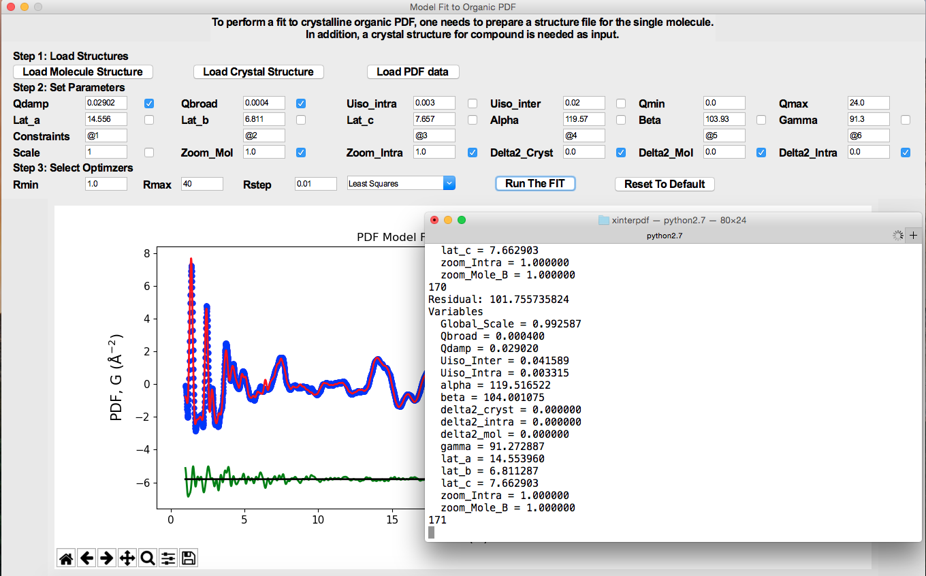
Usage 2: Model fit to organic crystalline PDF
Another capability of xINTERPDF is to perform a PDF fit to organic crystalline PDF. In Step 1, users load in structure files and PDF data. In step 2, various parameters are fixed or allowed to vary. In Step 3, the range of the fit and optimizers are further determined by users. Hit Run the FIT to start the refinement. After the fit is complete, the fit is plotted and fit results are printed on the terminal.

Slide 8
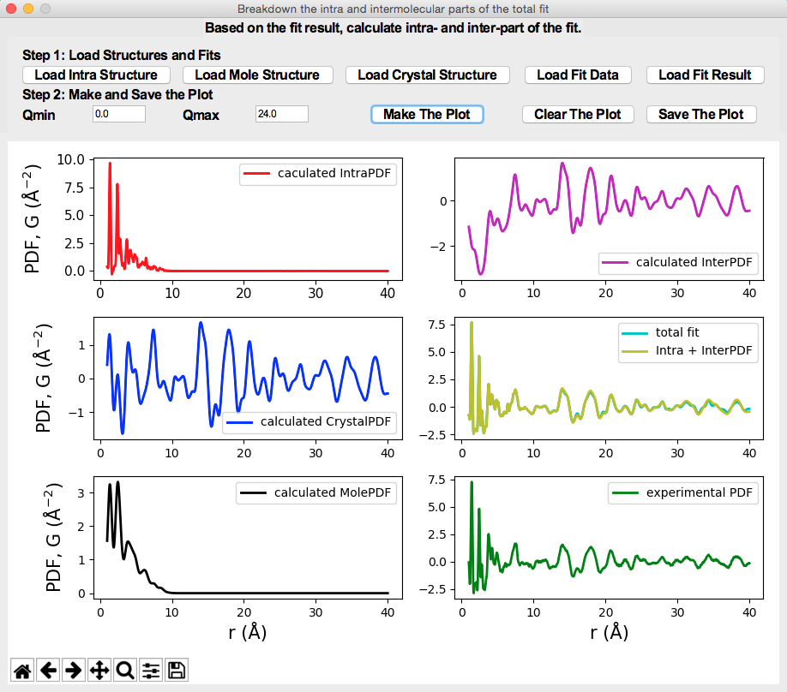
Usage 3: a breakdown of the model fit to organic crystalline PDF
After the PDF fit to crystalline X-ray PDF is done, the users can break down the total fit to intra- and intermolecular PDFs.

Slide 9
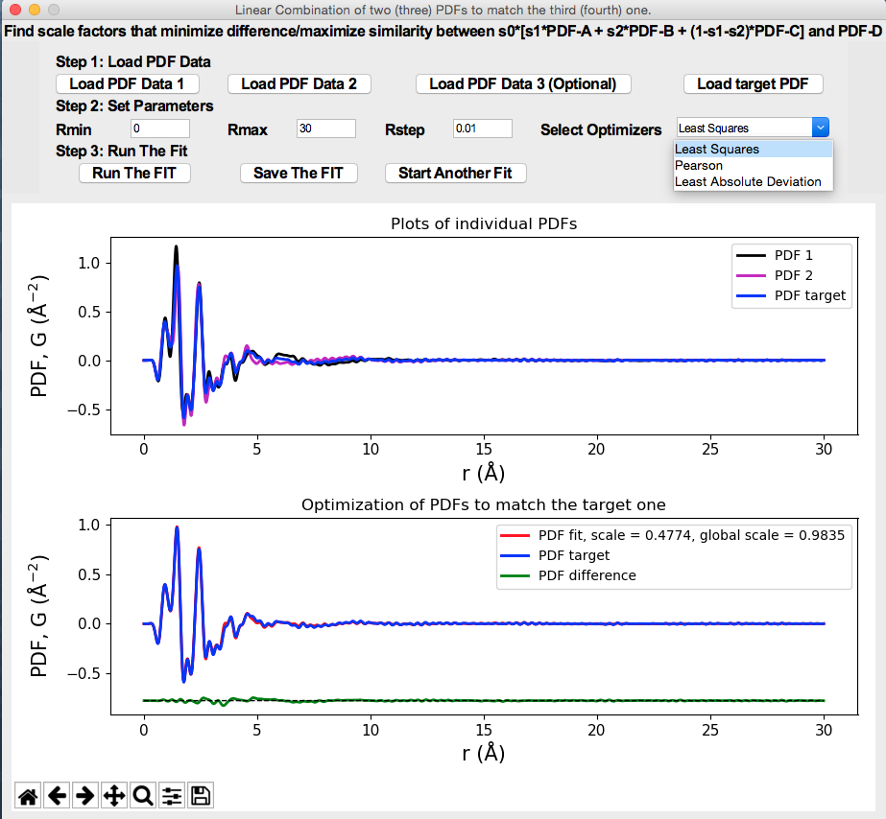
Usage 4: phase quantification
The program offers an easy functionality that takes in the PDFs of 2 or 3 pure materials and compares against a target PDF (e.g. physical mixture or amorphous solid dispersion of them). The scale factors are returned which encodes the info about phase fraction.

Slide 10
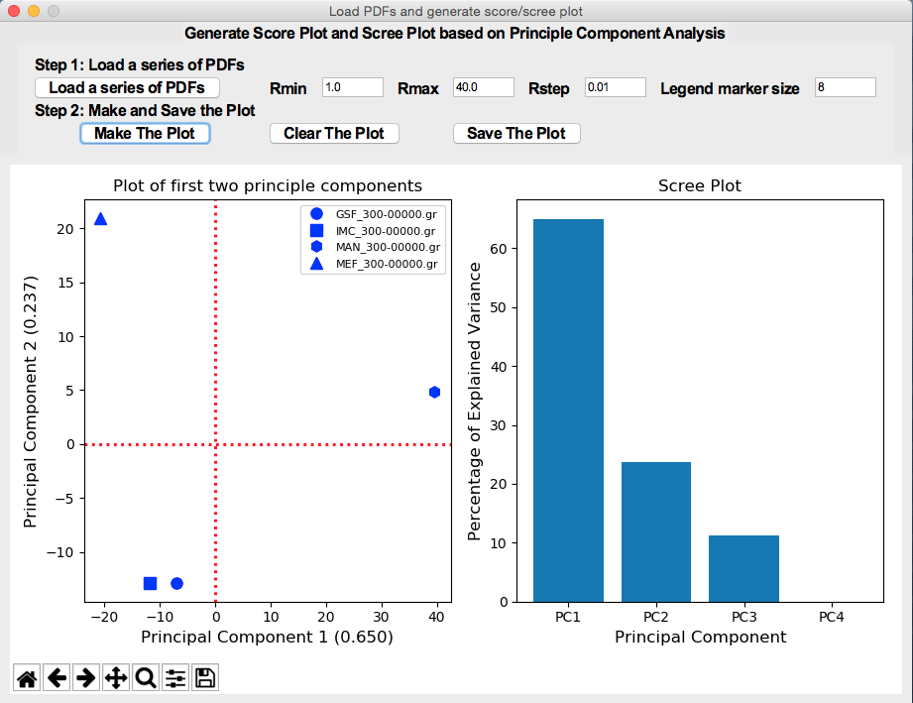
Usage 5: Principle Component Analysis
The program also provides an easy interface for generating Scree/Score plots of PDFs based on PCA analysis.

Slide 11
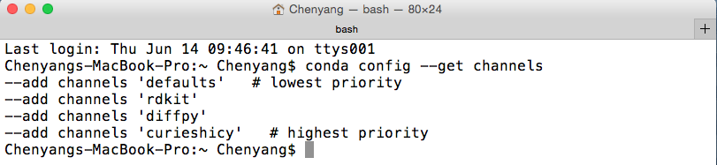
Installation
xINTERPDF can be installed on Linux and macOS 64 bit computers. The easiest way to install it is through conda. Here is an example of installing it on macOS 10.10.3.
Download Anaconda Distribution for macOS at https://www.anaconda.com/download/?lang=en-us#macos. Select Python 2.7 version to install.
Invoke a terminal, type conda config --get channels to check any channels that have been added. diffpy is required. If you don’t see it, type conda config --add channels diffpy to add it.

Slide 12
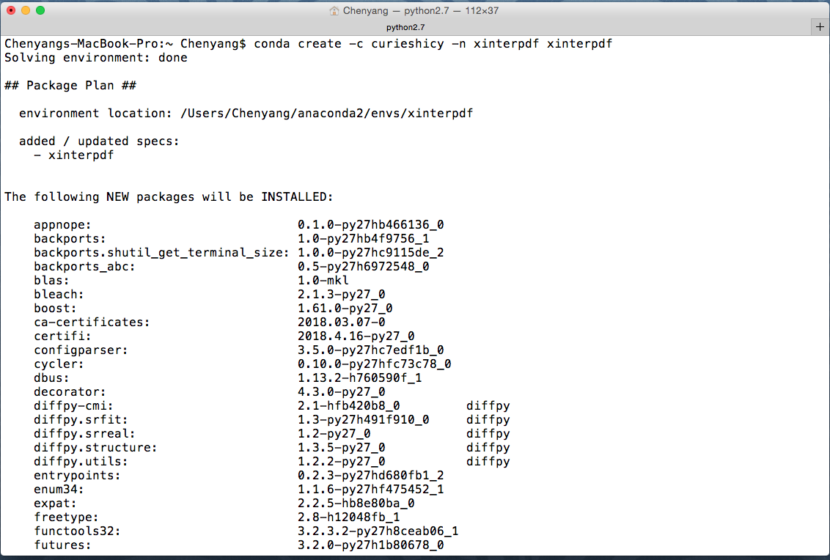
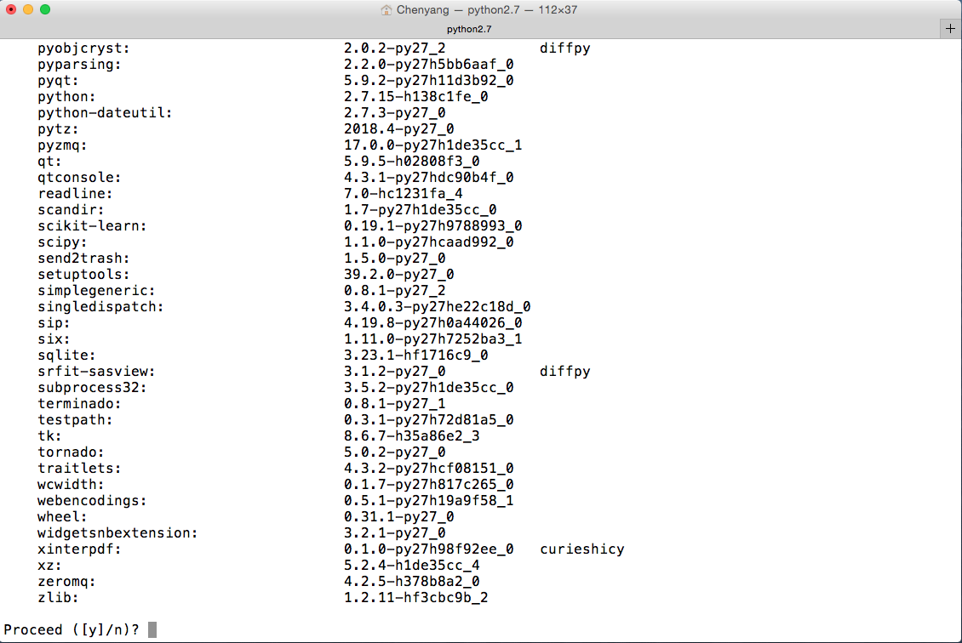
Installation
(3) Type conda create –c curieshicy –n xinterpdf xinterpdf to install it.

Slide 13
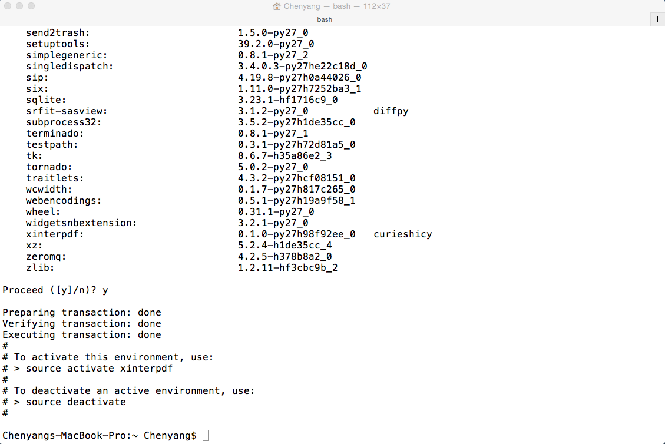
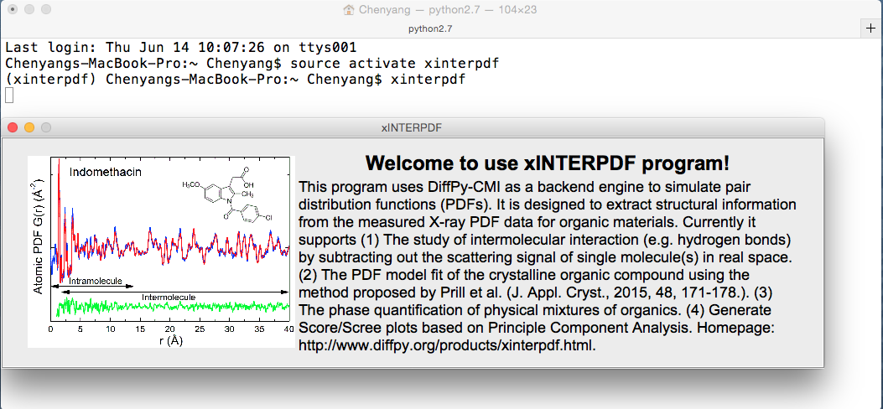
Installation
(4) Once the installation is complete. Type source activate xinterpdf to start the virtual environment and xinterpdf to invoke the main window of xINTERPDF.

Slide 14
Installation (alternative)
If conda install failed, alternatively, one may download the raw files (Logo.gif and cli.py) at https://github.com/curieshicy/xINTERPDF/tree/master/Conda_Recipe_macOS_Linux/Conda_Build_Recipe_macOS/xinterpdf (macOS) or https://github.com/curieshicy/xINTERPDF/tree/master/Conda_Recipe_macOS_Linux/Conda_Build_Recipe_Linux/xinterpdf (Linux). To start the program, in a terminal, navigate to the folder where you put both files, and type python cli.py to invoke the main window. Make sure you have installed Diffpy-CMI, matplotlib (2.0.2) and Scikit-Learn (0.19.1). Follow http://www.diffpy.org/products/diffpycmi/index.html to install DiffPy-CMI. If you have conda, matplotlib can be installed by conda install matplotlib=2.0.2; Scikit-Learn can be installed by conda install scikit-learn=0.19.1

Slide 15
Technical Details
xINTERPDF uses diffpy.srreal.pdfcalculator module to calculate PDFs. (http://www.diffpy.org/diffpy.srreal/api/diffpy.srreal.html?highlight=pdfcalculator#diffpy.srreal.pdfcalculator.DebyePDFCalculator). Specifically PDF Calculator (PC) and Debye PDF Calculator (DPC) are used to simulate PDF in real and reciprocal spaces, respectively.

Slide 16
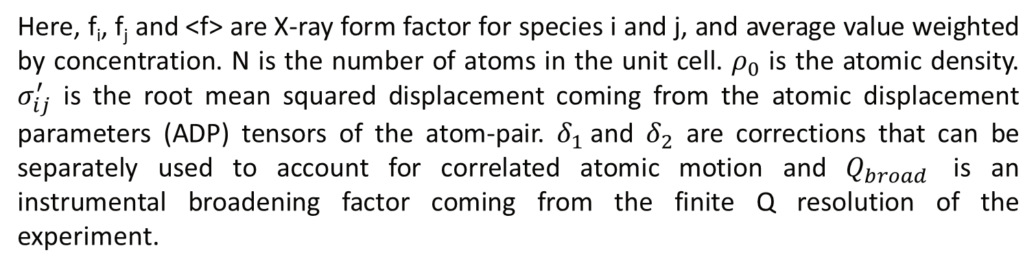
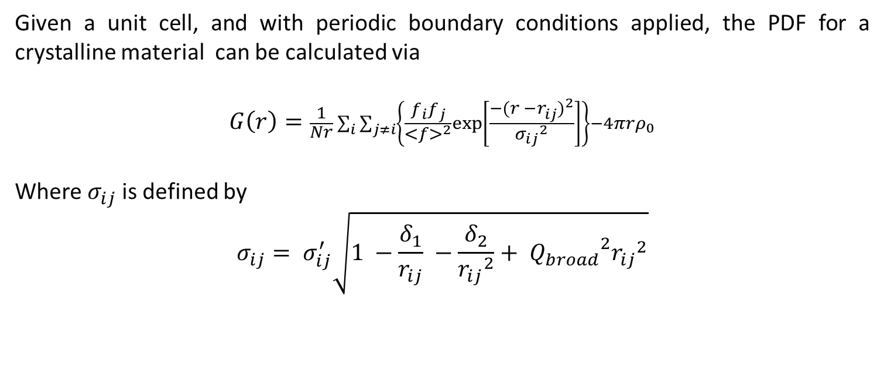
PDF Calculator (PC)
Given a unit cell, and with periodic boundary conditions applied, the PDF for a crystalline material can be calculated via
$$G\left(r\right)=\frac{1}{Nr}\sum_{i}{\sum_{j≠i}{\left\{\frac{f_{i}f_{j}}{{<f>}_{}^{2}}exp⁡\left[\frac{−{(r −r_{ij}^{})}^{2}}{{σ_{ij}}^{2}}\right]\right\}−4πrρ_{0}}}$$
Where $σ_{ij}$ is defined by
$$σ_{ij}= σ_{ij}^{′}\sqrt{1 −\frac{δ_{1}}{r_{ij}} −\frac{δ_{2}}{{r_{ij}}^{2}}+ {Q_{broad}}^{2}{r_{ij}}^{2}}$$
Here, f_{i}, f_{j} and <f> are X-ray form factor for species i and j, and average value weighted by concentration. N is the number of atoms in the unit cell. $ρ_{0}$ is the atomic density. $σ_{ij}^{′}$ is the root mean squared displacement coming from the atomic displacement parameters (ADP) tensors of the atom-pair. $δ_{1}$and $δ_{2}$ are corrections that can be separately used to account for correlated atomic motion and $Q_{broad}$ is an instrumental broadening factor coming from the finite Q resolution of the experiment.

Slide 17
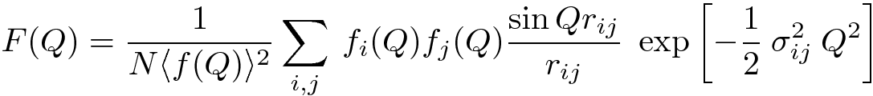
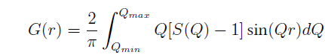
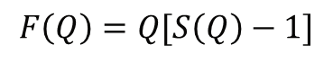
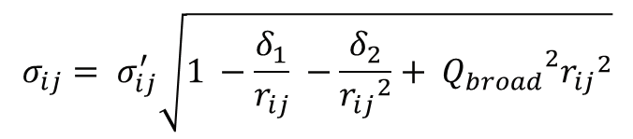
Debye PDF Calculator (DPC)
When using DPC to calculate PDF, first the reduced structure factor, F(Q), defined as Q[S(Q)-1], is calculated by Debye sum* and then it is Fourier transformed to obtain PDF, G(r). The relevant equations are listed below.
Using DPC one can calculate PDF from any structure given known coordinates (typically in xyz format). *Debye, P. (1915). Ann. Phys. 351, 809-823.
More details see Chapter 3 of Underneath the Bragg peaks: Structural Analysis of Complex Materials, 2nd ed.; Elsevier: Amsterdam, The Netherlands, 2013.
$$F\left(Q\right)=Q[S\left(Q\right)−1]$$
$$σ_{ij}= σ_{ij}^{′}\sqrt{1 −\frac{δ_{1}}{r_{ij}} −\frac{δ_{2}}{{r_{ij}}^{2}}+ {Q_{broad}}^{2}{r_{ij}}^{2}}$$

Slide 18
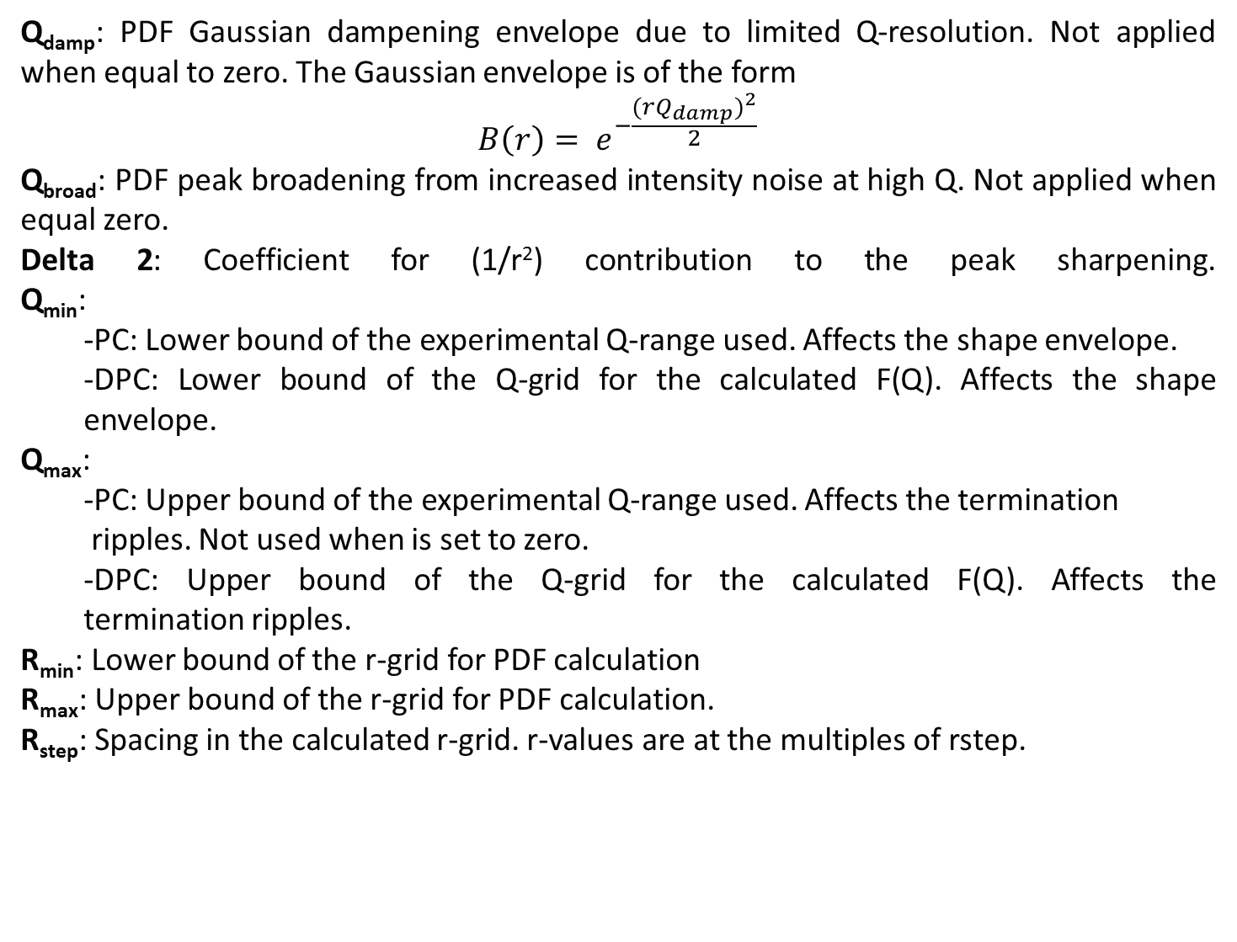
Explanation of parameters
Q_{damp}: PDF Gaussian dampening envelope due to limited Q-resolution. Not applied when equal to zero. The Gaussian envelope is of the form
$$B\left(r\right)= e^{−\frac{{(rQ_{damp})}^{2}}{2}}$$
Q_{broad}: PDF peak broadening from increased intensity noise at high Q. Not applied when equal zero.
Delta 2: Coefficient for (1/r²) contribution to the peak sharpening. Q_{min}:
-PC: Lower bound of the experimental Q-range used. Affects the shape envelope.
-DPC: Lower bound of the Q-grid for the calculated F(Q). Affects the shape envelope.
Q_{max}:
-PC: Upper bound of the experimental Q-range used. Affects the termination ripples. Not used when is set to zero.
-DPC: Upper bound of the Q-grid for the calculated F(Q). Affects the termination ripples.
R_{min}: Lower bound of the r-grid for PDF calculation
R_{max}: Upper bound of the r-grid for PDF calculation.
R_{step}: Spacing in the calculated r-grid. r-values are at the multiples of rstep.

Slide 19
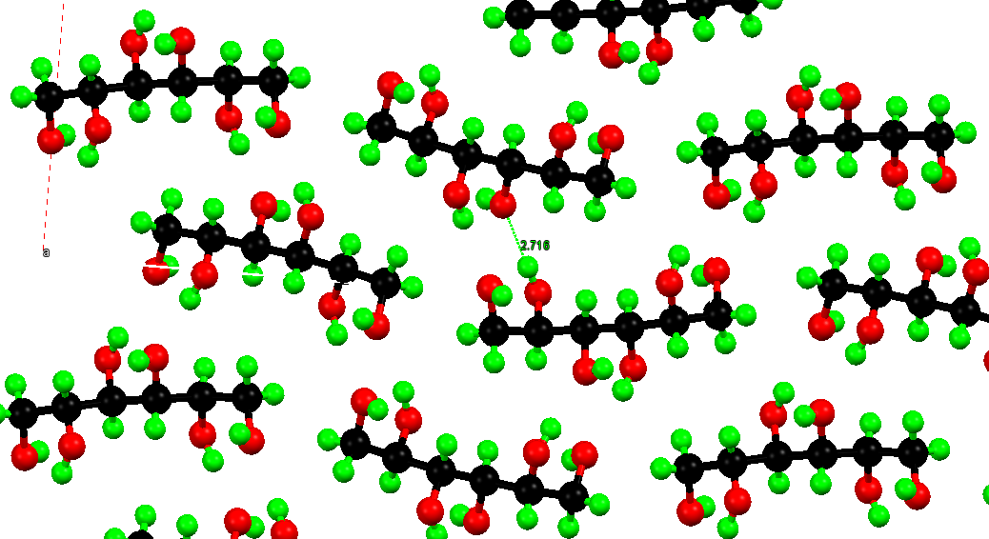
Example 1: Hydrogen bonds in D-mannitol
D-mannitol is a polyalcohol with rich hydrogen bonds. Based on its room temperature (283-303 K) structure as reported by Kim et al, the nearest O…O bond distance is ~2.72 Å.
Synchrotron X-ray total scattering was conducted on D-mannitol powder sample at 300 K. From a fit to PDF of cerium oxide, the instrumental resolution parameters are determined: Q_{damp}=0.02902 Å⁻¹, Q_{broad}=0.0004 Å⁻¹. A Q_{max} of 24 Å⁻¹ was used for Fourier transform. The software program PDFgetX2 was used.
Examples files are available at https://github.com/curieshicy/xINTERPDF/tree/master/Examples.
H. S. Kim, G. A. Jeffrey and R. D. Rosenstein, Acta Cryst. B, 1968, 24, 1449.
X. Qiu, J. W. Thompson and S. J. L. Billinge, J. Appl. Cryst. 2004, 37, 678.

Slide 20
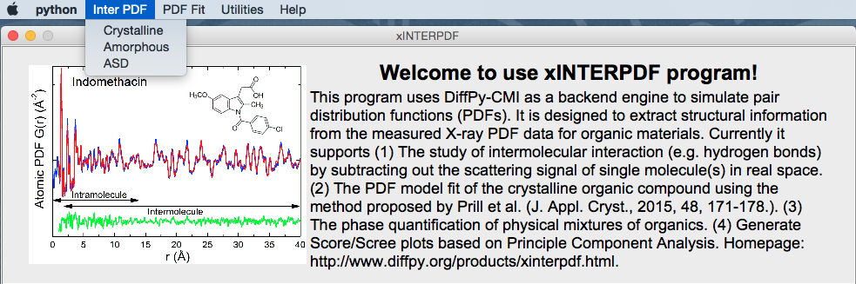
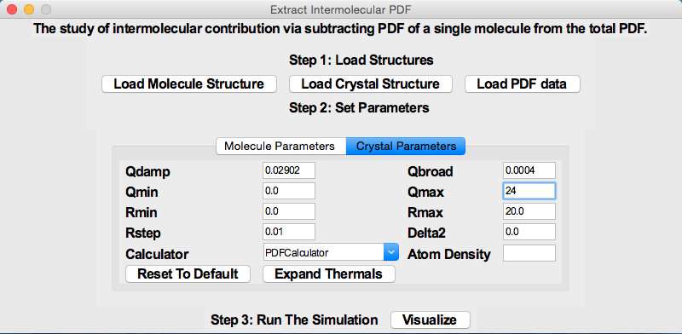
Example 1: Hydrogen bonds in D-mannitol
After invoke the main window in a terminal, select from drop-down menu, Inter PDF /Crystalline, which brings up a new window titled Extract Intermolecular PDF.
Following the Steps: first load in files for molecule (MAN.xyz), crystal (MAN.cif) and PDF data (MAN_300-00000.gr). In step 2, set Q_{damp} and Q_{broad} values to those determined from cerium oxide calibrant; set Q_{max} to 24 Å⁻¹.
For molecule DebyePDFCalculator is used; while for crystal, PDFCalculator is used. Click Expand Thermals for both molecule and crystal. Leave values at default.
In step 3, click Visualize to see the plots.

Slide 21
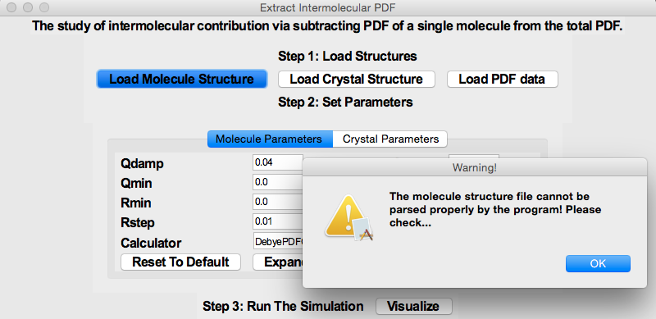
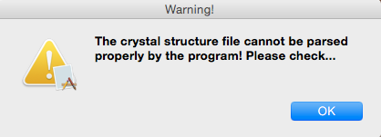
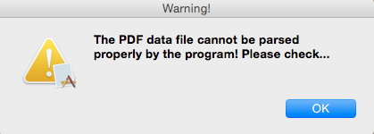
Example 1: Hydrogen bonds in D-mannitol
If any of the molecule/crystal structure file or PDF data cannot be recognized by the program, an error message will be displayed to alert the users.

Slide 22
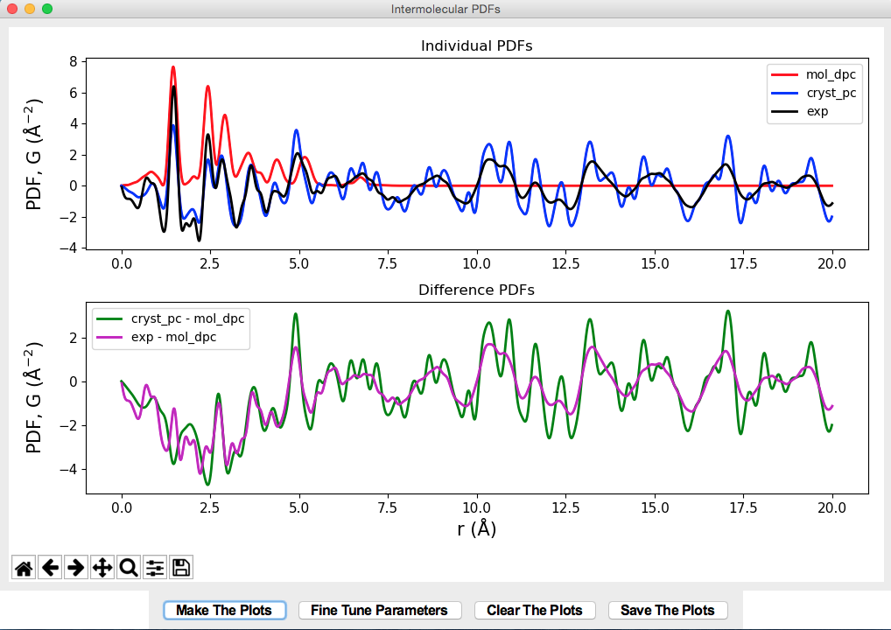
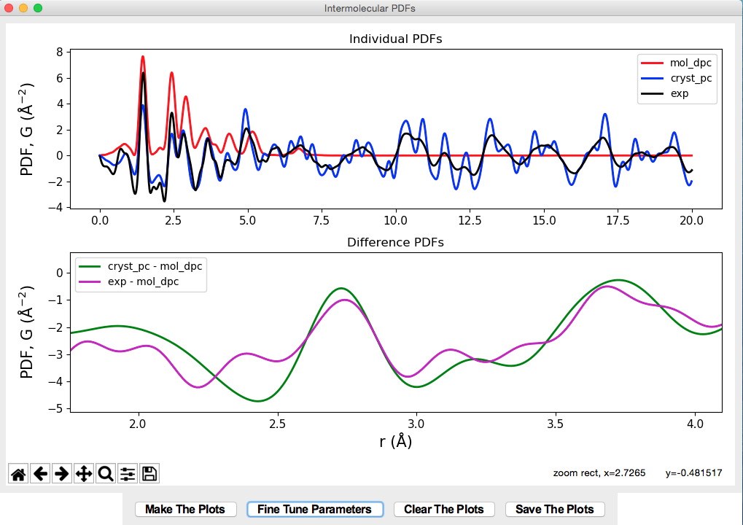
Example 1: Hydrogen bonds in D-mannitol
Click Make The Plots, the theoretical PDFs for molecule and crystal, together with experimental PDF are plotted in the top panel. In the bottom panel, the difference PDFs from experiment and theory are compared. Using magnifying tool in the embedded navigation toolbar, one can zoom into the peak around 2.7 Å. Hovering the mouse in the region, the peak positions for O…O is ~2.72 Å and ~2.74 Å, respectively.

Slide 23
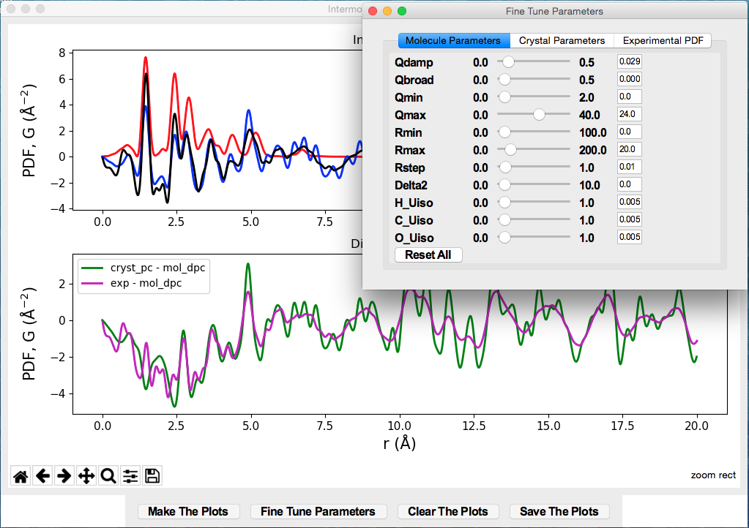
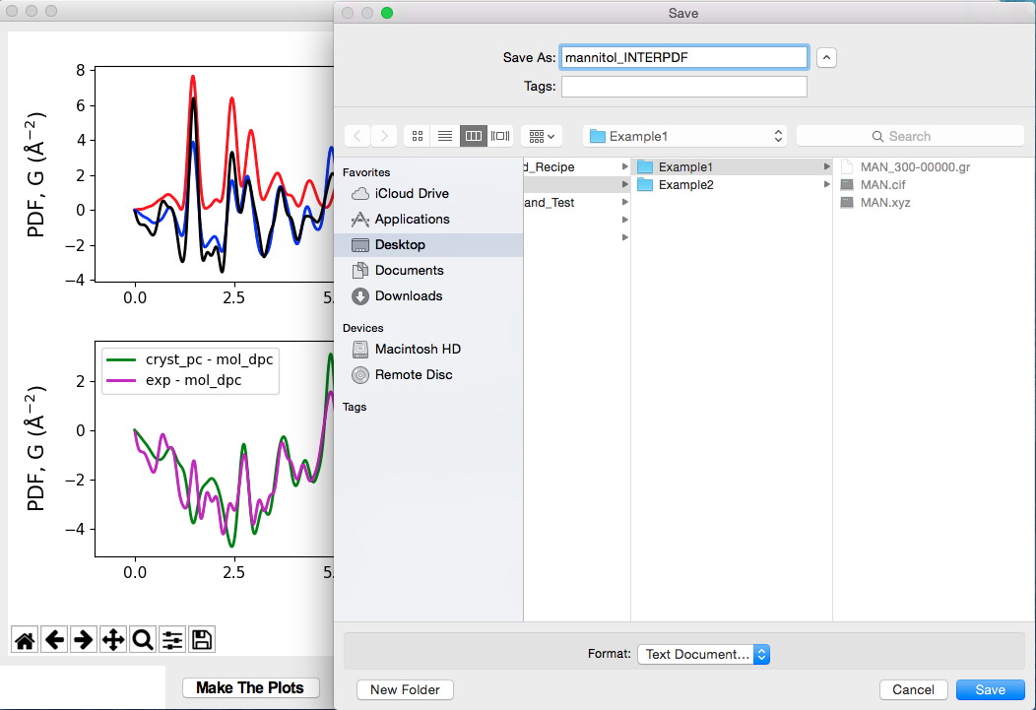
Example 1: Hydrogen bonds in D-mannitol
Hit Fine Tune Parameters to bring about a window for fine tuning parameters. It has three tabs for molecule, crystal and experiment data, respectively. Users can either drag the scale bar or type a number in the entry box and hit Enter. The plots will update in real time.
Click Clear the Plots to erase the plots. Click Save The Plots to save all raw data.

Slide 24
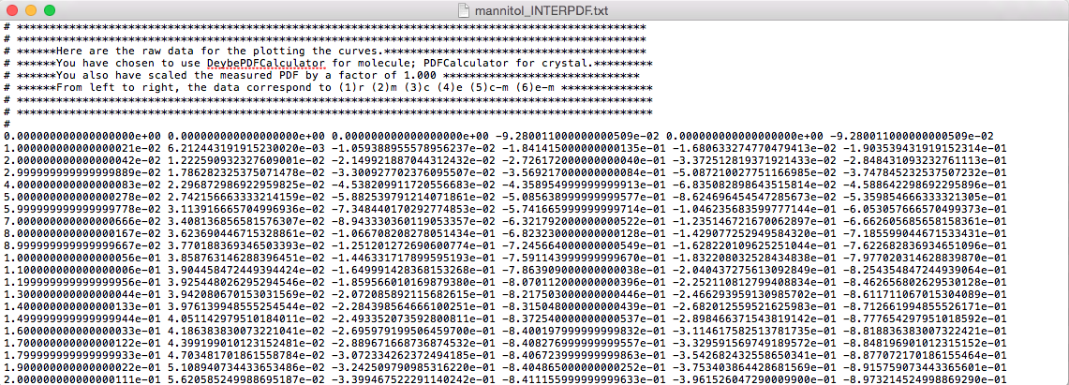
Example 1: Hydrogen bonds in D-mannitol
In the file that saved, the header explains the details of each column of data saved. In this example, it describes the Calculators used for simulating PDFs for molecule and crystal, and the scale factor used (in Fine Tune Parameters tab) for experimental PDF. Each column, from left to right, corresponds to, respectively, (1)the radial distance, (2) theoretical PDF for molecule, (3) theoretical PDF for crystal, (4) experimental PDF, (5) theoretical intermolecular PDF and (6) experimental intermolecular PDF.

Slide 25
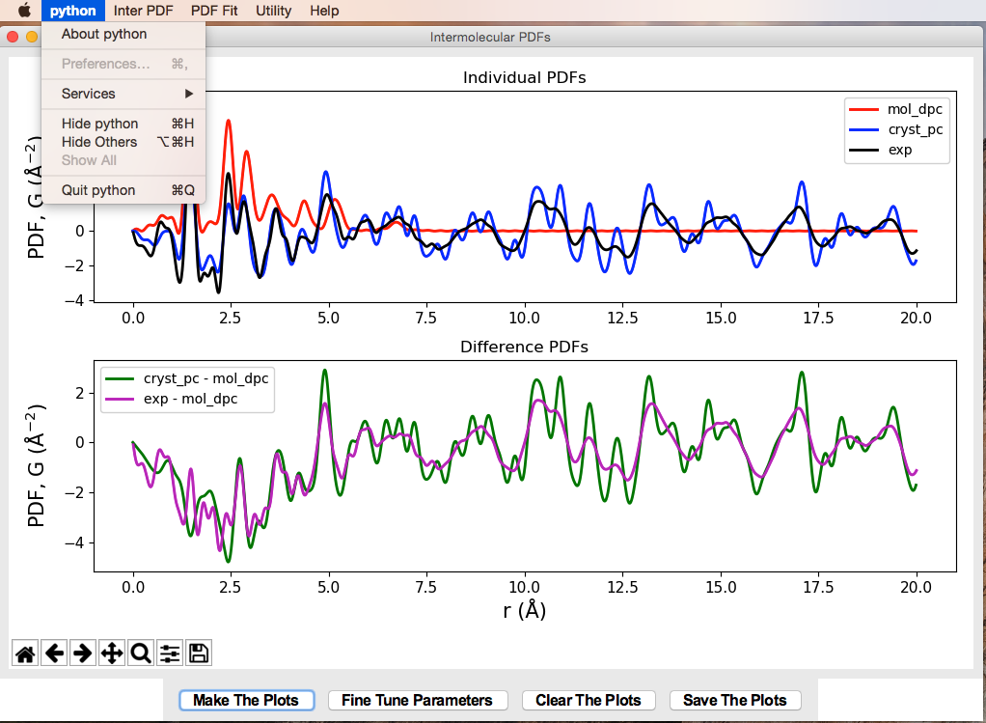
Example 1: Hydrogen bonds in D-mannitol
In the dropdown menu, click Python---Quit Python to quit. If terminal fails to respond, press Crtl + Z to kill the process.

Slide 26
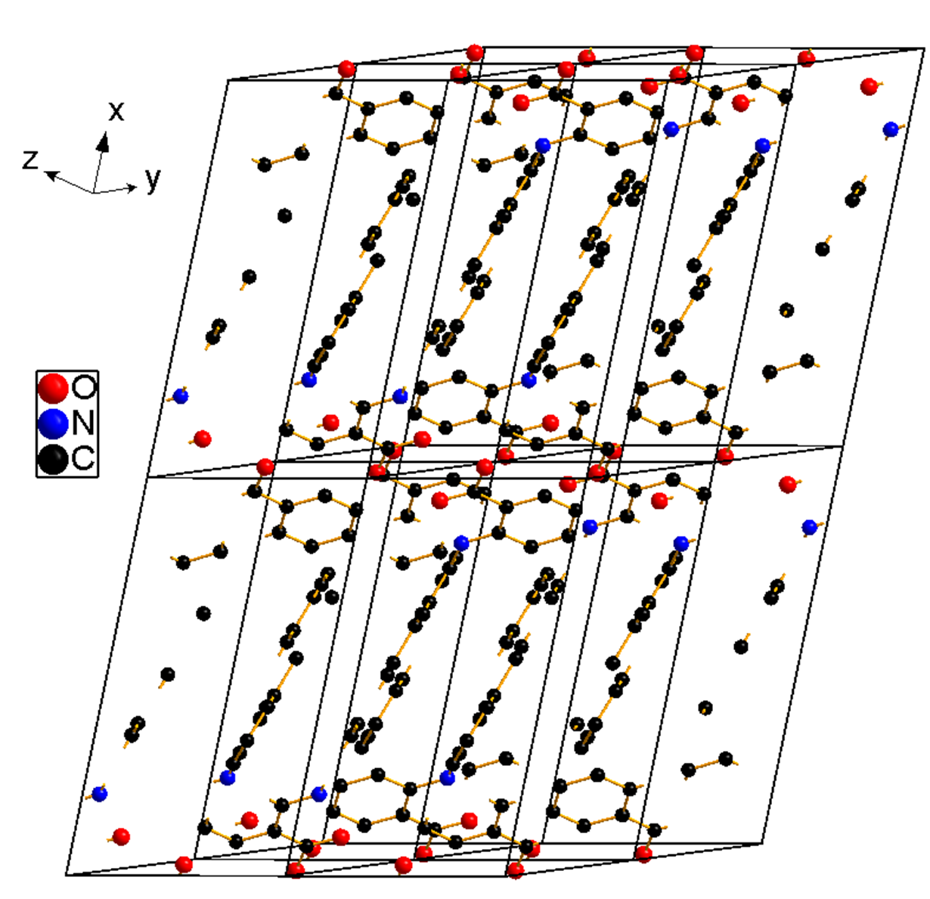
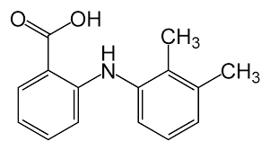
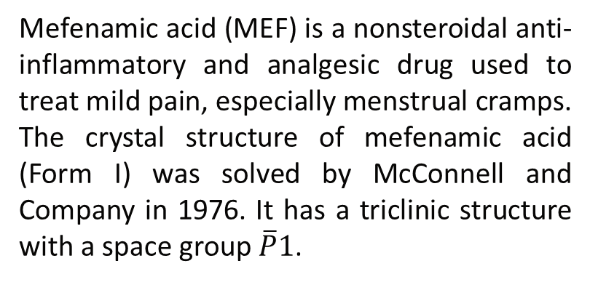
Example 2: Model fit of MEF crystalline PDF
Mefenamic acid (MEF) is a nonsteroidal anti-inflammatory and analgesic drug used to treat mild pain, especially menstrual cramps. The crystal structure of mefenamic acid (Form I) was solved by McConnell and Company in 1976. It has a triclinic structure with a space group $\overline{P}1$.
Synchrotron X-ray total scattering was conducted on MEF powder sample at 300 K. From a fit to PDF of cerium oxide, the instrumental resolution parameters are determined: Q_{damp}=0.02902 Å⁻¹, Q_{broad}= 0.0004 Å⁻¹. A Q_{max} of 24 Å⁻¹ was used for Fourier transform. The software program PDFgetX2 was used.
J. F. McConnell and F. Z. Company, Cryst. Struct. Commun. 1976, 5, 861-864.

Slide 27
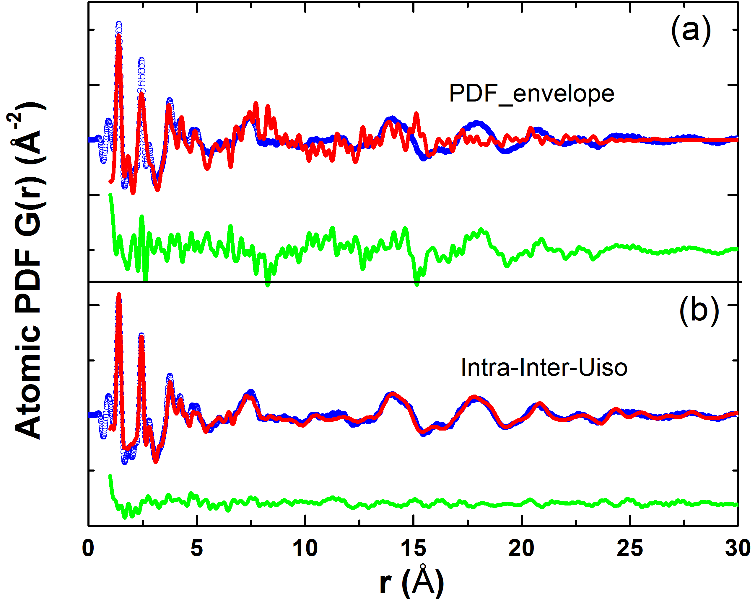
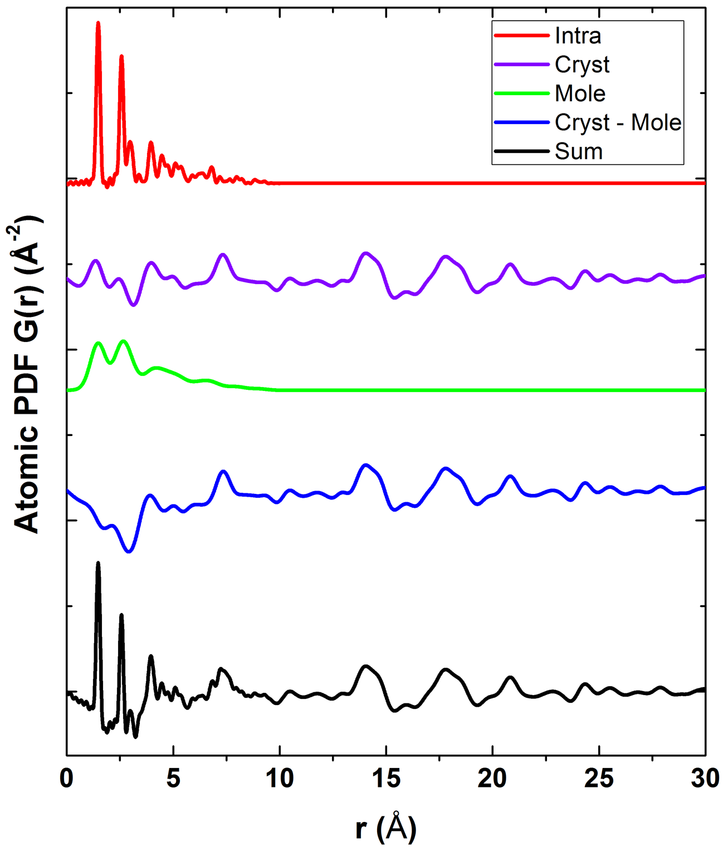
Example 2: Model fit of MEF crystalline PDF
As Prill et al. reported, the PDF of organics cannot be modelled well by expanding unit cell as typically done for inorganic materials (left figure a), because the intermolecular forces are weaker than intramolecular ones. Instead, a model differentiating both intra- and intermolecular contributions is more appropriate. As shown in the breakdown of a total PDF for MEF (black curve in the right figure), it has contributions from intra- (red) and inter-molecules (blue), each with a distinct U_{iso} thermal factor.
D. Prill, P. Juhás, M. U. Schmidt and S. J. L. Billinge, J. Appl. Cryst. 2015, 48, 171-178.

Slide 28
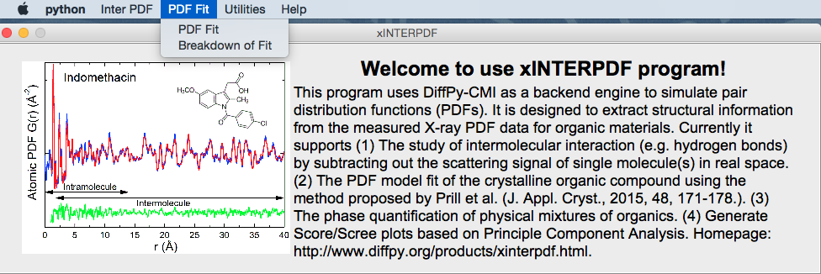
Example 2: Model fit of MEF crystalline PDF
To perform a PDF fit, in dropdown menu, click PDF Fit/PDF Fit to start the GUI window.

Slide 29
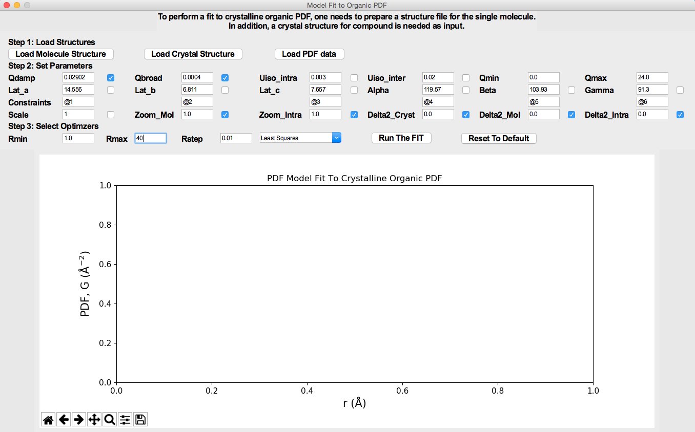
Example 2: Model fit of MEF crystalline PDF
Following the steps, first load in structure files and PDF data (MEF.xyz, MEF.cif and MEF_300-00000.gr). In Step 2, specify the parameters. If a check box is marked, that parameter is fixed during the fit; otherwise is allowed to vary.
Below lattice parameters, there is a row for constraining them. For example, if it is a cubic structure, users can type @1 for Lat_a, Lat_b and Lat_c.
For a tetragonal structure, @1 for Lat_a and Lat_b, @2 for Lat_c. Similar syntax is applied to constrain the angles (Alpha, Beta and Gamma). Since MEF is triclinic, we need six different variables for lattice parameters. Zoom_Mol and Zoom_Intra give the possibilities to expand or shrink the molecule isotropically. The three delta 2 values can be further freed to explain for the r-dependent peak width (i.e. correlated motions). Refer to the right figure in Slide 27, for the meaning of Mol and Intra.
In Step 3, select the fit range and optimizer. Hit Run The Fit to start the run.

Slide 30
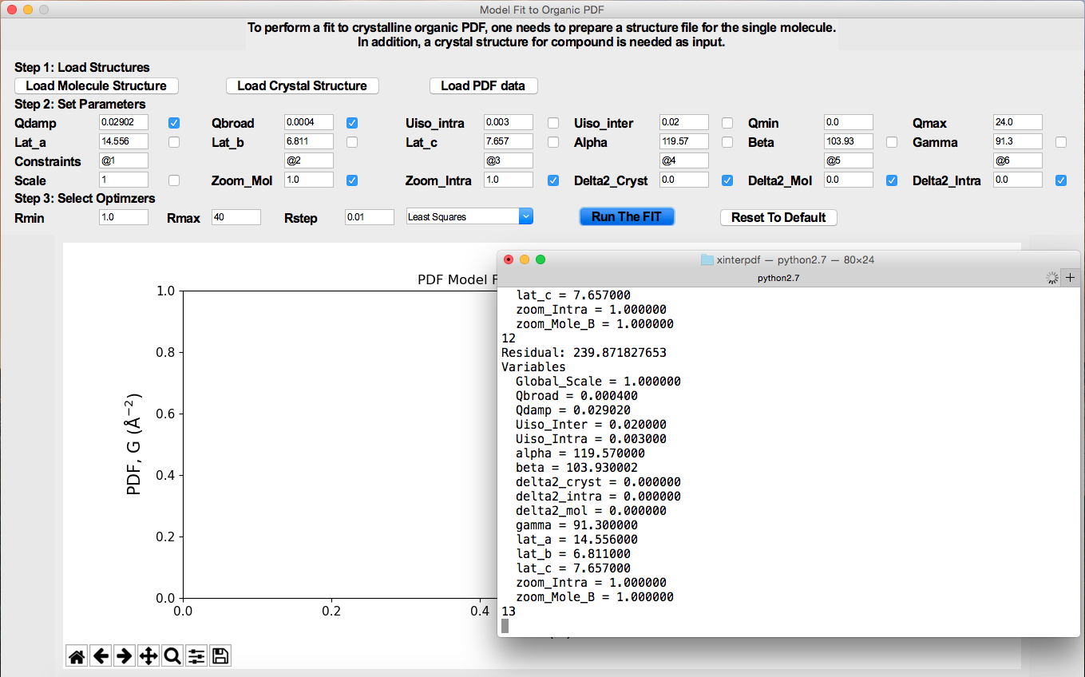
Example 2: Model fit of MEF crystalline PDF
When the fit starts running, the terminal will update fit parameters in real-time.

Slide 31
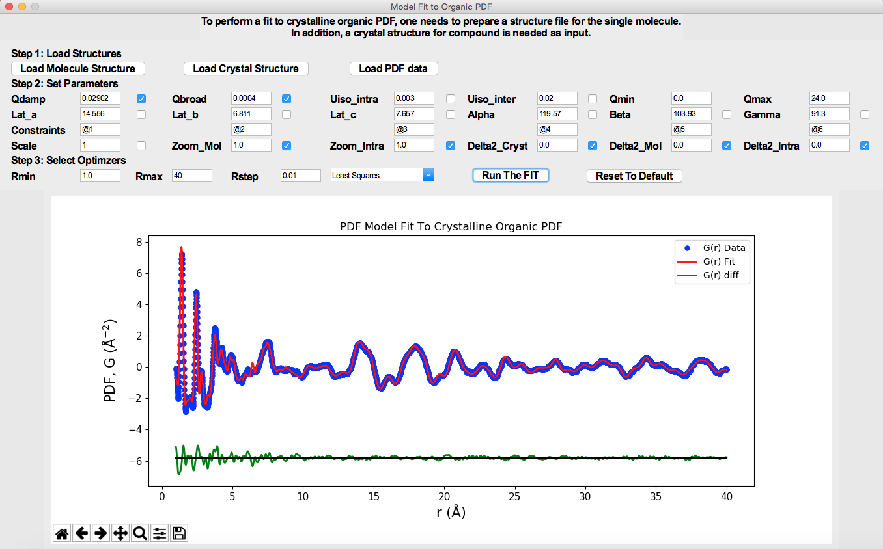
Example 2: Model fit of MEF crystalline PDF
When the fit is complete, the fit result is plotted. Blue circles, red and green curves, correspond to measured, calculated and difference PDF, respectively.

Slide 32
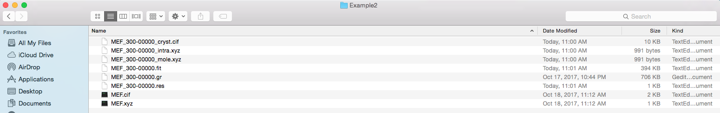
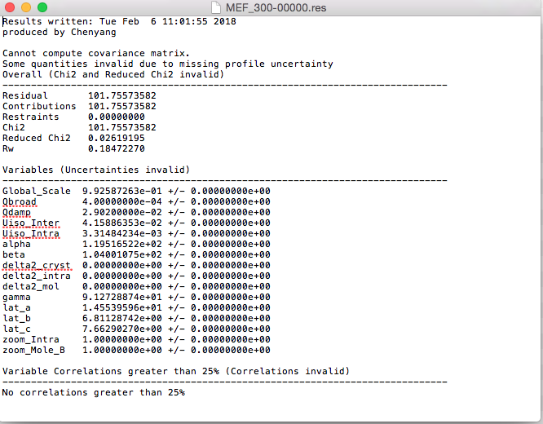
Example 2: Model fit of MEF crystalline PDF
After the fit is complete, a variety of files will be saved automatically to the folder where structure files exist. These include structure files (.cif and .xyz files). The MEF-300-00000.fit contains raw data for plotting. MEF-300-00000.res contains a detailed summary of fit results. See the screenshot shown to the left.

Slide 33
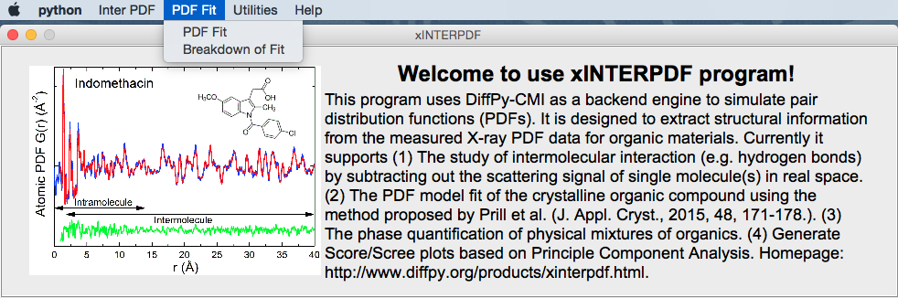
Example 3: Breakdown of the total PDF fit in Example 2
A functionality Breakdown of Fit has been built to calculate intra- and inter-molecular PDF contribution to the total fit. The interface is shown in the next page. It takes in five files generated after a fit to the crystalline organic X-ray PDF (as in example 2).
The five files from example 2 loaded into program are:
MEF-300-00000_intra.xyz
MEF-300-00000_mole.xyz
MEF-300-00000_cryst.cif
MEF-300-00000.fit
MEF-300-00000.res
Besides, in Step 2, the user needs to specify the Qmin and Qmax values used for simulation of molecular PDFs.

Slide 34
Example 3: Breakdown of the total PDF fit in Example 2
After loading all five files separately and specifying the Qmin/Qmax, hit Make The Plot will generate plots of each contribution to the total fit.

Slide 35
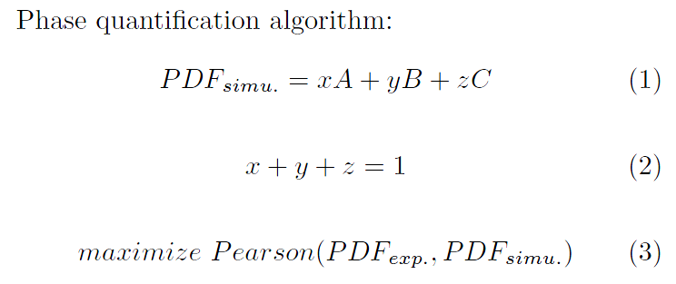
Example 4: Find phase fraction by regression
This exercise is also important for differentiating amorphous solid dispersion (ASDs) and physical mixture of amorphous drug and polymer, i.e. test the miscibility of drug and polymer. If the final product is a physical mixture, one should be able to scale the PDFs of each component to match the total PDF. However, if it is a pure ASD, the linear combination of PDFs of end members should not yield a desired result. More details see A. Newman et al., J. Pharm. Sci. 2008, 97(11):4840-56.
Or minimize the difference between PDF_{exp} and PDF_{simu}

Slide 36
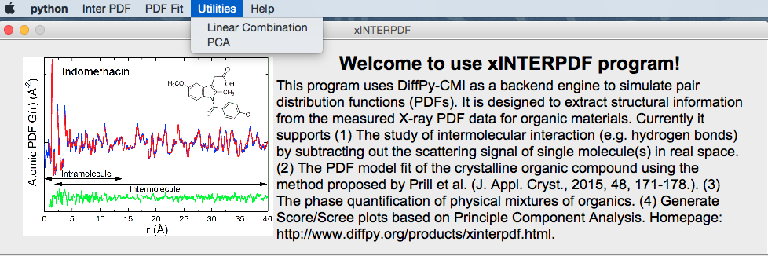
Example 4: Find phase fraction by linear regression
To perform a linear fit, in dropdown menu, click Utility/Linear Combination to start the GUI window.

Slide 37
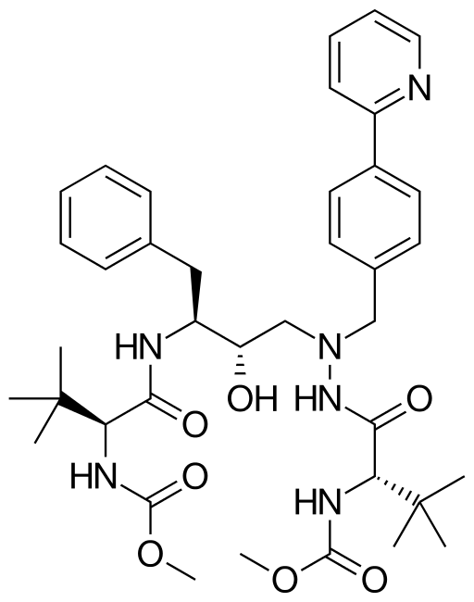
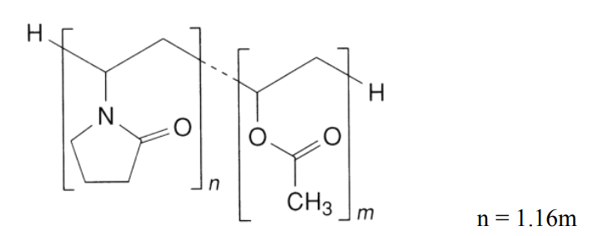
Example 4: Work on amorphous solid dispersion data
Copovidone
Atazanavir
Amorphous solid dispersion (ASD) was prepared by rotovap. Polymer weight was corrected for water moisture (6.0 wt%). Based on weight percentage, the samples are named rA25C75, rA50C50, rA75C25, rC100 and mA100 (pure atazanavir amorphous phase was prepared by melt quench method).
Synchrotron X-ray PDF experiment was done at 11-ID-B at 250 K, with a Q_{max} = 20 Å⁻¹.

Slide 38


Example 4: Work on amorphous solid dispersion data
Samples | Nominal | Least Squares | Pearson | Least Absolute Deviation
rA25C75 | 25.0 | 25.4 | 25.4 | 24.8
rA50C50 | 50.0 | 47.7 | 47.8 | 46.3
rA75C25 | 75.0 | 77.8 | 77.8 | 75.8

Slide 39

Example 5: Principle Component Analysis (PCA)
Principle component analysis is an unsupervised learning method, which is used for dimensionality reduction, and clustering. A functionality PCA is built in Utilities. Given a set of PDF data, the program automatically generates Score plot and Scree plot at the same time. See next page for example usages, where synchrotron X-ray PDFs of indomethacin (IMC), mefenamic acid (MEF), mannitol (MAN) and griseofulvin (GSF) measured at RT are loaded into the program. It can be seen IMC and GSF cluster together in the Score plot, indicating similar structural features. By hitting Save The Plot, each principle component of every compound is saved.

Slide 40
Example 5: Principle Component Analysis (PCA)

Slide 41
Disclosure/Acknowledgement
■ AUTHOR INFORMATION
Corresponding Author
*E-mail: chenyang.shi@abbvie.com. Phone: +1 847-935-3328.
ORCID
Chenyang Shi: 0000-0002-2291-7325
Notes
C.S. is the employee of AbbVie and may own AbbVie stock. The design, study conduct, and financial support for this research were provided by AbbVie. AbbVie participated in the interpretation of data, review, and approval of the publication.
The author declares no competing financial interest.
■ ACKNOWLEDGMENTS
C.S. thanks various individuals from Drug Product Development (Research and Development) at AbbVie for their helpful insights and discussions. C.S. thanks Drs. Karena Chapman, Kevin Beyer and Olaf Borkiewicz at beamline 11-ID-B, Argonne National Lab for assists of collecting PDF data. C.S. appreciates suggestions from Dr. Pavol Juhás, Prof. Lian Yu and Dr. Fabia Gozzo.

